Slide 1


Enhancing Credit Risk Assessment
MIS 6060 - ADVANCED DATABASE AND BIG DATA MANAGEMENT
Marko Khotynetskyi, Vyshali Poola, Vishaka Sharma
Presented to: Dr. Vijayan Sugumaran

Slide 2





Introduction
Institution
Objective
USA National Bank is a national credit card provider.
Strengthen transaction security, detect fraud early, and unlock valuable customer insights.
Approach
Data warehousing and BI tools turn raw data into actionable insights.

Slide 3
Dataset Overview
What Data Do We Have?
Dataset
Key Info Captured
Customers
Demographics, credit score, income
Credit Cards
Card type, limit, expiry
Transactions
Amount, time, fraud flag
Merchants
Category, location
Chargebacks
Dispute reason, resolution
Branches
Geographic location
Fraud Rules
Definitions and triggers

Slide 4
Use Case Summary Table
Our data-driven approach targets key areas. The goal is to leverage data for fraud detection and risk management.
Use Case
Objective
Key Variables
Value
Fraud Detection
Spot fraud in real-time
Amount, Merchant, Time
Reduce losses
Risk Profiling
Understand customer risk
CreditScore, Income
Manage exposure
Branch Analysis
Compare performance
BranchID, Transactions
Optimize ops
Chargeback Trends
Track disputes
DisputeReason
Improve Customer experience
Card Management
Improve card usage
CardType, CreditLimit
Retain customers
Segmentation
Personalize offers
Merchant Category, Income
Boost Revenues

Slide 5




Problem Scenario
Rising Fraud Risk
Limited Visibility
Credit card fraud grows more complex, threatening finances and reputation.
Lack of centralized data prevents a complete view of customer behavior or merchant risk.
Delayed Detection
Chargebacks & Disputes
Fraud patterns remain hidden until after the financial damage occurs.
High dispute rates reduce customer trust and increase operational overhead.

Slide 6
Managerial Questions & DW/BI
What We Want To Know
How DW/BI Helps
High-risk customers?
Integrates Merchants data.
Fraud trends by type?
Regional Performance View.
Fraud Trends based on credit score?
Enables segmentation by Credit Score.
Faster fraud detection?
Supports real-time insights.

Slide 7
How We Made the Data Work
1
Synthetic Data
2
SSIS ETL Pipeline
Python scripts generated banking transactions. Synthetic data mimics customer profiles.
The ETL pipeline extracts, cleans, and transforms raw data. It is then loaded into SQL Server.
3
Data Mining
4
ML Models
OLAP cubes uncover multi-dimensional insights. KPIs identify high-risk segments.
Fraud detection models classify transactions. Models include Random Forest, Logistic Regression and XGBoost.

Slide 8

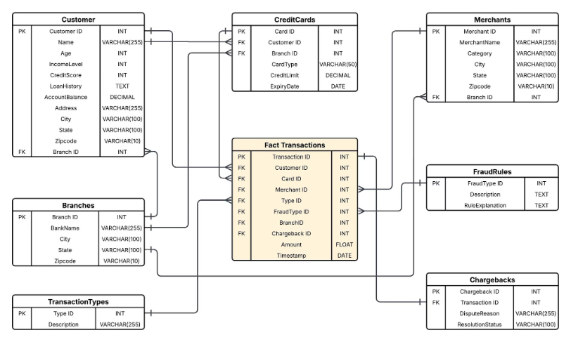
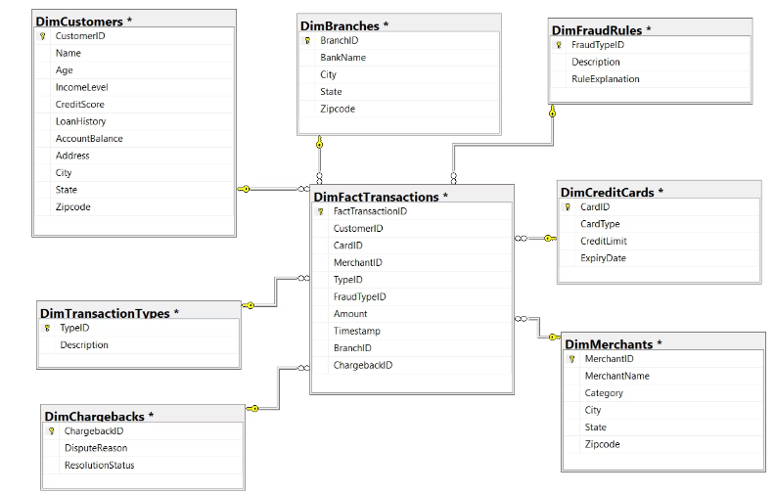
Data Model and Data Warehouse Schema

Slide 9
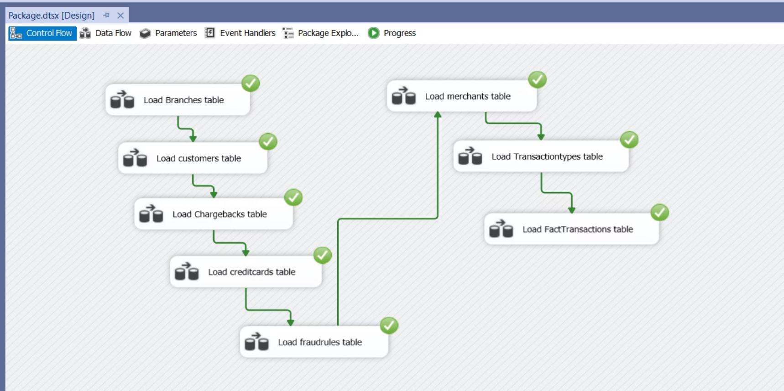
SSIS Control Flow: End-to-End ETL Pipeline

Slide 10
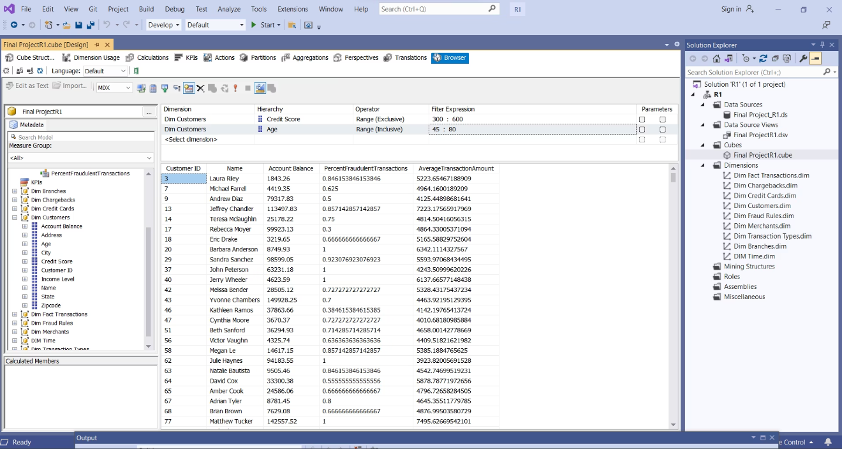
Identifying High-Risk Customers
Enables targeted fraud analysis and supports decisions in
credit risk scoring
monitoring
intervention.

Slide 11
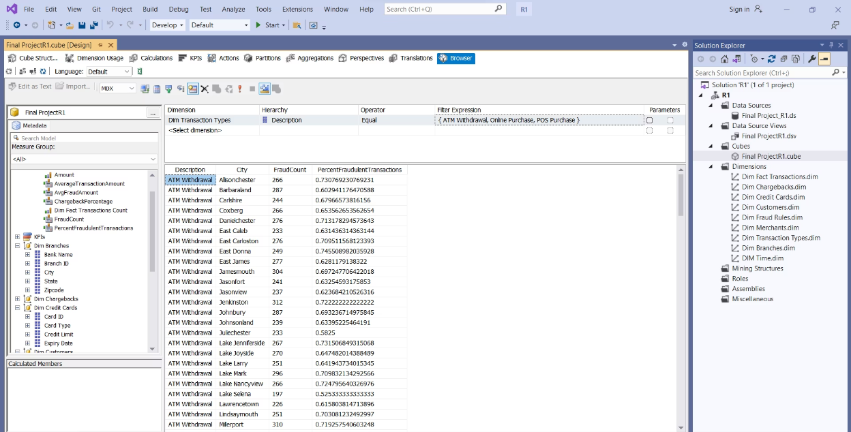
Analyze Fraud Trends by Transaction Type
Enables better decision-making for
Fraud detection
Prevention policies

Slide 12
ML Models
1
Data Engineering
2
Flagging
3
Algorithms
Engineered features like average transaction amount and days since last transaction.
Identified high-risk merchants, online transactions, and chargebacks.
Employed Logistic Regression, Random Forest, and XGBoost models.

Slide 13
Performance Summary & Key Insights
Model
Precision
Recall
F1
Accuracy
Logistic Regression
0.78
0.84
0.81
0.73
Random Forest
1.00
0.69
0.82
0.79
XGBoost
1.00
0.69
0.81
0.79
Random Forest and XGBoost offer perfect precision. This leads to fewer false positives in flagging fraud.
Logistic Regression delivers higher recall. It is better at identifying more instances of actual fraud.

Slide 14
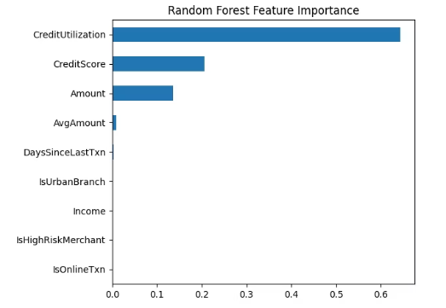
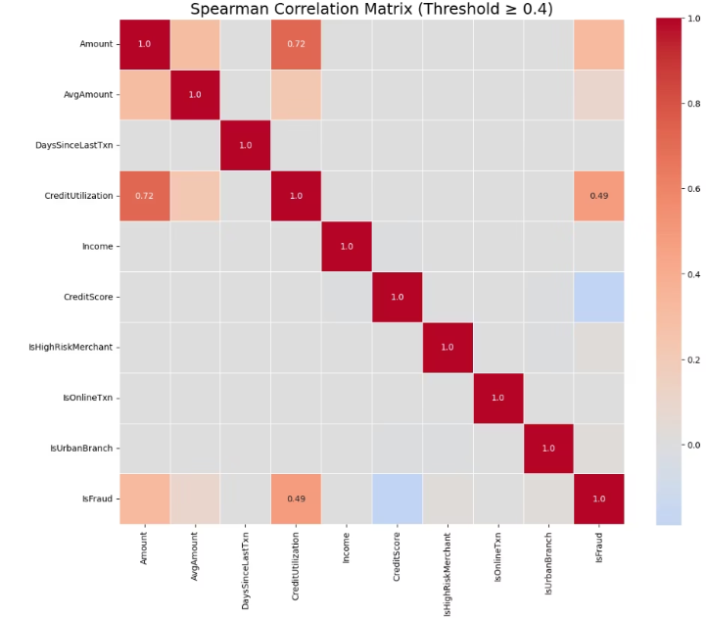
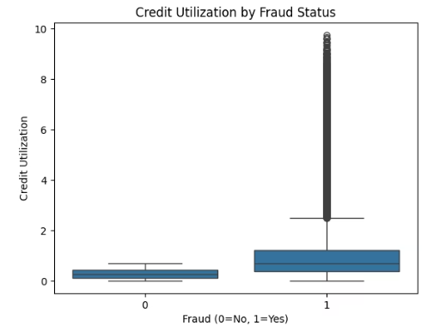
Feature Importance and Correlation Analysis
Transaction Amount and Credit Utilization show a strong positive correlation with fraud (IsFraud), indicating they are significant predictors.

Slide 15
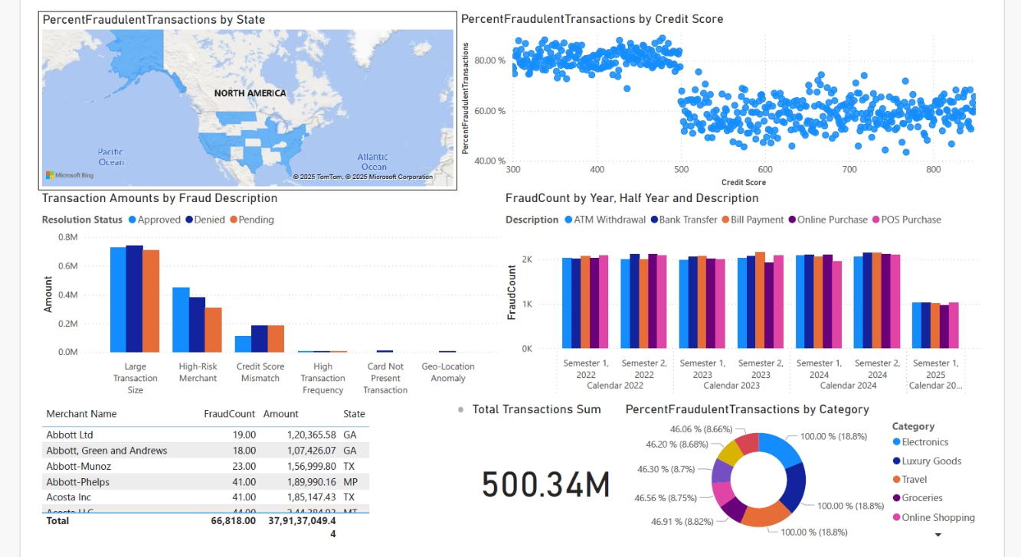
Business Intelligence Dashboard

Slide 16




Summary and Lessons Learned
DW/BI Improves
Data Quality
Fraud detection, automation, and reporting.
1
2
Importance of consistent data for accurate risk models
Credit decisioning
Visual Analytics
4
3
ETL Optimization
Simplify insights to non-technical users
Enhances performance

Slide 17

Thank You

